Slide 1

Test Driven Development
Answering some whys and hows with Python

Slide 2

What we will cover
Why Test Driven Development?
How to start using Test Driven Development
Live Demos
Practice exercise
Recommended Resources
Notes:
So we are going to cover a number of things today, including;
How Test Driven Development is different to both the Test After and Test First approaches
What benefits Test Driven Development brings,
I will work through some demos to show you how I write my code in a Test Driven way, so you can actually see this happening in real time.
I'll introduce so software engineering principles that will not only make your code easier to test, but also easier to change going forward
Then we’ll put what we’ve learnt into practice with a hand’s on exercise – So I will be looking for a volunteer to do some live coding later
….
I’m not expecting you all to be experts by the end of this session.
I strongly believe that this is a skill that takes time time click, especially if you have been writing code for a long time without it.
So I expect that it will take time for everyone to really feel at home with Test Driven Development.
It is a different way of working, and a different way of thinking, and therefore requires time for us to adapt….
We may be going over some old ground for those of you who have been doing this a bit longer.
Please bear with me while I ensure everyone has the same foundation to work from.

Slide 3
Out of scope … for now!
Unit Tests Vs Integration Tests Vs Outside-in Tests
Docker & CI Pipelines
Mocks Vs Stubs Vs Spies
Slack Channel
#﻿test_driven_development_workshop
Notes:
Some of the things we won’t cover today, just because of time constraints:
- Unit Tests Vs Integration Tests Vs Outside-in Tests – what’s the difference, which is better and why, pros and cons
We just want to get to grips with the basics. However, these are good, important conversations to have.
- Running our tests in Docker or on our build agents – Hopefully, you’ll understand by the end why I’m deferring any conversations about running our tests in Docker etc for another day.
Today I want to focus on the developer experience in the IDE.
- Mocks Vs Stubs Vs Spies ….There is a nice post by Martin Fowler which explains the difference between these different types of test doubles. But we won’t be going into the pros and cons of each.
Obviously, feel free to ask any questions you have about any of this stuff in the Slack Channel later.

Slide 4

Who is this guy?
Notes:
I thought before we started I ought to tell you a little bit about my self, not to brag or convince you why you ought to listen to me, rather just to give you a little context on what my Test Driven Development journey has been like, and where I’m coming from.
I’ve been a Dev now for about 20 years, mostly in .Net and it’s various flavours.
I’m mostly an object orientated guy, but recently I’ve got really into the Functional way of doing things too.
I’ve been with CTM now for about 12 years, and have worked in many roles:
From dev, senior dev, tech lead, and even department development manager.
My first experience with Test Driven Development was at my previous company, when I was a very inexperienced dev.
I don’t really think I understood the value it was giving us back then.
So when I left that role and came to BGL, where we didn’t do this, I didn’t really pursue it.
Then a few years later, CTM decided to shake things up a bit and got ThoughtWorks in to show us how software ought to be written.
I was lucky enough to be one of a few people drafted onto the Project to build the new credit cards journey, which would include Agile and XP techniques, including Test Driven Development.
And it was then that It really started to fall into place for me – working with a group of devs that were clearly sold on this approach and the benefits that it brought, but who were also willing to teach us how to do it.
That was about 8 years ago maybe. I’ve been a Test Driven Developer ever since.
The only time I really skip the test first approach is when I’m playing around with things and learning. But even then, sometimes I find it useful to write tests in order to answer questions I have about how things work – I find it’s a really quick way to step into the detail of the code and debug.
So, that’s a little about me now onto the interesting stuff.

Slide 5
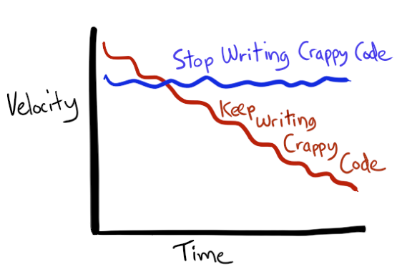
Tests are First Class Citizens too
“The product owner didn’t ask for tests….why should we treat them with the same respect we give to the production code?”
Notes:
So the number one thing we need to establish about testing before we start is:
that tests are first class citizens too!
If we treat our tests as anything other than first class citizens then they degrade and rot.
They become hard to read and hard to maintain. And When things are hard, the problems get worse.
So, When people say things like,
“The customer is paying for features, not tests”
Or
“It’s the production code that pays the bills, not the tests”
Yes, but the customer is paying for WORKING features.
The value of the tests is that they tell us that the production code works.
And that is why we value the tests, because otherwise we have to validate that ourselves and manual testing if mind-numbingly dull.

Slide 6
What Test Automation gives us
Fast, Reliable, Repeatable
Confidence building
Feedback Loops
Notes:
I don’t really think I need to give the hard sell on test automation, so we won’t labour on these points too long.
I think we can all agree that the automation of testing is a good thing.
- It reduces the amount of time and effort we need to spend launching & running the application, and manually walking through test scenarios in order to evaluate if we have (A) correctly implemented the required change, and (B) not broken any existing features in the process
It gives us this feedback faster than we could ever hope to achieve if we were to do this manually
It’s more consistent than us humans: the machine will do exactly the same thing each time the test runs, it wont forget a step or a scenario, and doesn’t get distracted by external noise such as email, or the post man knocking on the door or slack
It’s fast, reliable, and repeatable
And these 3 qualities give us confidence to move forward, happy that we aren't breaking anything

Slide 7
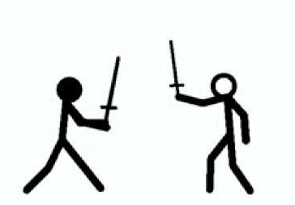
Test After vs Test Before vs Test Driven
Notes:
So if we can all agree that test automation is the way forward, the next step is to discuss the different types of Test.
Or to put it more accurately, the different processes available for creating our tests.
So let’s delve into the differences between Test After, Test Before, and Test Driven Development

Slide 8

Test After
“I’m nearly done…
I just need to write the tests”
Notes:
So first up, “Test After”:
First we make our changes or additions to our production code base….
Then we finish the job by writing the tests to validate that what we did actually works.
And you can tell who does it this way around, because we will often here phrases like this during stand up:
“Yep, it’s going well. I’m pretty much done…I just need to write the tests”
I know that there is at least one person here who has said something like this before….I know, because it was me!….I’ve said these words before during stand up.
However, there are a couple of problems with the test after approach
So lets delve into these a bit

Slide 9
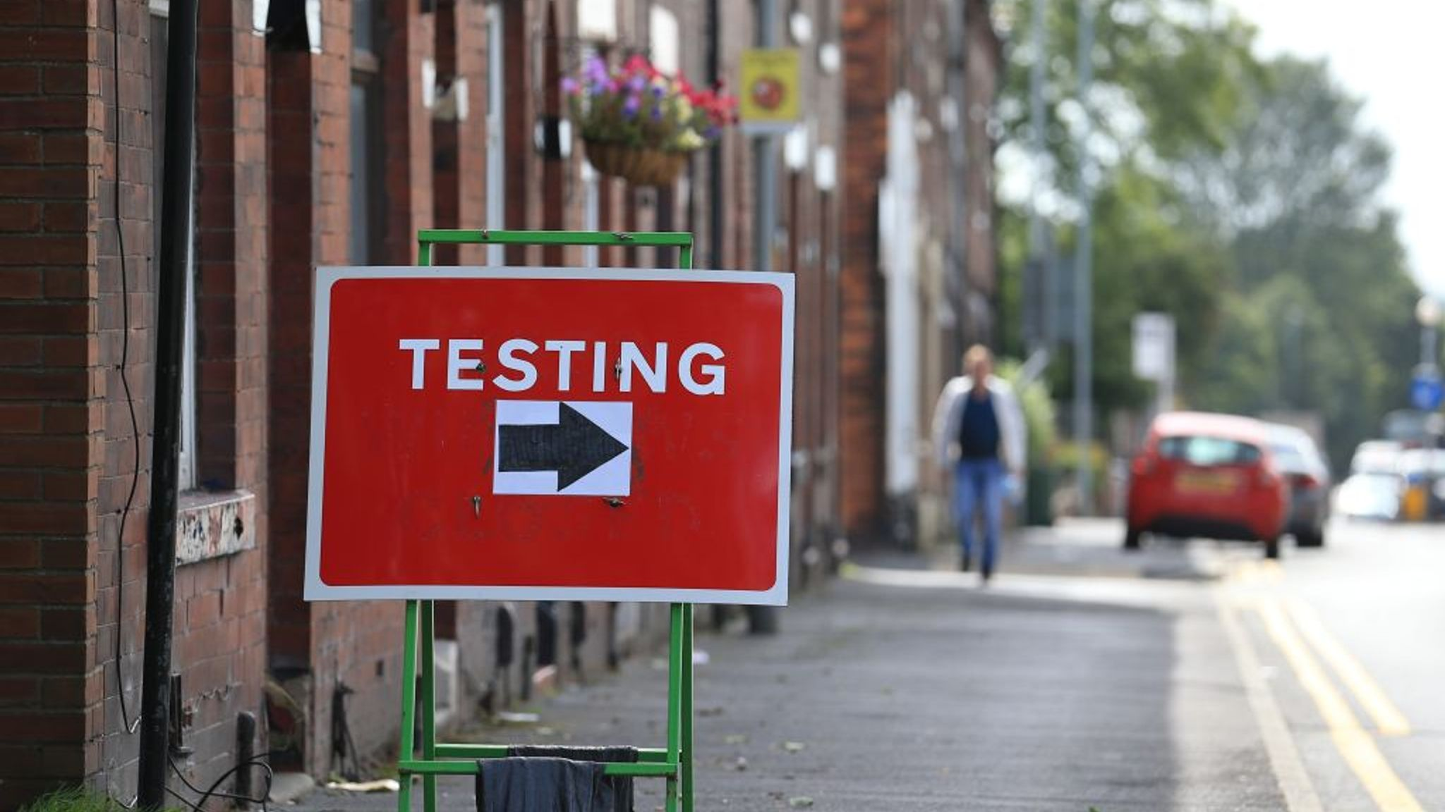
Test After: Problems
Sensitive to time pressures, and human nature
Working code may need to change to bring it under test
False Positives
Notes:
1) If you are feeling pressure from someone to get something out the door (maybe you’re applying pressure to yourself, or your DM or Product owner is chasing you for a delivery), and you have already finished implementing the functional requirements of a particular change or feature, then writing the tests, particularly while test automation is new and unfamiliar, is one of the first things to suffer.
Certain scenarios or edge cases will be skipped or missed, either consciously or accidentally.
This is natural, because in your head you’ve finished.
This is human nature.
2) To compound this first issue, there is also the fact that writing tests after you have written the code you are trying to test, could actually be harder to do than if you had written the test first.
This is because you’re probably not writing code that is easily open to automated testing. Certainly not if test automation is not yet embedded in your delivery process.
You may find that you need to refactor working code in order to bring it under test.
We’ll come back to this point and expand later.
3) Finally there is the problem of False positives: You’ve implemented the change, then you write the test to validate it’s working and it goes Green. Job done!
Only later you find that there was an bug in your code, and the test was also wrong, so didn't expose the defect.

Slide 10

Test First to the rescue
First write a test
See if fail
Write the code to make it pass
Notes:
We can however, alleviate all of those issues by writing our tests first.
We write a test to validate the new requirement.
We run the test and see it fail.
Then we implement the change in the production code and see the test pass.
This reduces the issue of False positives – because we have witnessed a change in the status of the test…it was failing and now it’s passing.
It also reduces the likelihood of us skipping or missing some test scenarios, because we don’t consider the job done until the production code is complete, AND we writing the tests first!
And you should even improve the testability of the code you are creating:
Since we’ve fundamentally changed our definition of done to explicitly include passing tests, we will now be writing code that is more testable…
Which should make testing easier….which will also make testing faster.
Again. We’ll come back to this point later to delve into HOW writing tests first improves the testability of your code.

Slide 11

Test First vs Test Driven
Test Driven not just about Tests – it’s a design process
Production code generated from tests
It’s a by-product of the tests
This may seem counter-intuitive at first
Notes:
Hopefully by now you’re little more sold on the idea of test first, rather than Test After.
Now we need to differentiate between Test First Development and Test DRIVEN Development.
There is a reason why I keep repeating the full name: “Test Driven Development” rather than reducing it to it’s more commonly used three letter acronym.
That’s because it looses some of the meaning when you say TDD.
Test Driven Development means exactly that: Development DRIVEN by, and from, our tests.
The differences are quite subtle, and I suspect that a demonstration is in order, but let me try to explain first.
TDD Is not just about tests, its also a design process:
In test driven development, we use the process of creating our tests to design the API of the subject under test.
Or to put it another way, the design of the API of the thing we are testing, is actually a by-product of our tests.
So during the test creation, we get to put ourselves in the shoes of a consumer of our API and say : “What do I want this method signature to look like? How do I want this function to behave?”
Our design, and our implementation, literally emerges from within our test.
This may seem a little backwards and unnatural to start with…but trust me, it works.
Time for a demo to drive home what I’m trying to say.

Slide 12
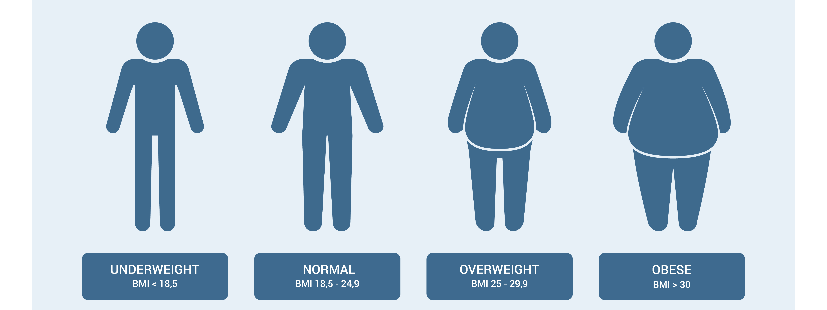
Context: BMI Calculator
Formula
BMI = mass (kg) / height² (m)
Notes:
Ok, so I’m going to implement a BMI calculator to work out just how unhealthy I’ve got during lock-down.
This is a simple warm up example to kick us off, we’ll ramp up the complexity a bit later when you lot have a go.
So you can see that our BA has provided us with the formula we need to complete the job.
So we need to feed our height and weight into here and return the BMI to 2 decimal places.

Slide 13

1st Demo – Live coding!
Starting simple – we’ll add more complexity later
BMI Calculator
Formula:
BMI = mass (kg) / height² (m)
Notes:
Can everyone see the code on screen?
So I’m using PyCharm here, which I think most of you are using too. I’m enjoying the developer experience so far – a few little issues, but pretty good!
I’ve already created an empty project with an empty test file. And you can see the requirements listed there, along with some sample test case data.
So step 1: understand the problem…., I kind of understand what I need to do here….I need to take these 2 inputs (height and weight) and generate a numeric output representing the Body Mass Index and then round it
Ok
Step 2: Lets name our test…something that describes what I'm trying to do…
def test_calculate_bmi():
Next
Step 3: Ok, I’m going to introduce a pattern called Arrange, Act, Assert. Some of you are probably already aware of this, so I’ll just take a few moments to ensure that everyone is on the same page.
This basically defines a template for how we are going to layout each of our tests in our test suite – this will create consistency throughout, and reduce cognitive load when you come to read each other’s code, enabling you to cut through the noise quickly and understand what’s going on
We already have a rough idea of the WHAT we are trying to do from the test name, but the HOW is defined from the body of the test.
Arrange Act Assert, just helps with speeding up understanding the HOW
So starting at the bottom and working our way up
First we have the Assert.
This is where we validate that executing our test subject yielded the results we were expecting
The Act – this is the point where we execute the code we are trying to test….
And then at the top we have the Arrange stage, and this is where we create or setup all our prerequisites for executing the subject under test: creating instances, managing dependencies, things like that.
Ok. Step 4: I’m going to start designing the Api of the THING that will eventually perform this calculator for me.
I’m referring to it as THING now, because I don’t yet know what I’m going to call it.
actual_bmi = BodyMassIndex.calculate(184, 74)
So here I have decided that I want to call a static method on a BodyMassIndex class, called calculate, and this is going to take 2 arguments, height in cm, and weight in kg, and its going to return a bmi value back to me.
I’ve obviously got a red squiggle here, because the code has no Idea what I’m talking about, because that class doesn’t exist yet.
So Next step is to make that squiggle go away, using as little effort as possible.
So I’m going to use the tools in the IDE to generate that class for me.
I’m not going to worry about it living in the same file as the tests right now, we can move that later.
So now the squiggle is gone I’m going to write my assert
assert actual_bmi == 21.86
So now I’ve got no squiggles to worry about, but obviously nothing is going to work yet because that calculate doesn’t exist yet,
So lets create that, again, with as little effort as possible….just enough to get the test running.
Again, I’m going to use the EDI to generate as much code as possible for me.
Now I’ve not figured out how to get the IDE this, so I’m going to manually change it to a @staticmethod, and get rid of that cls parameter ---
Lastly I’m return a zero so that the test fails.
So lets run our test.
There we go, we can see that the test has failed, not with errors, but because the hard coded result of zero doesn’t match our expectations.
Right – time to make the test pass then.
So lets add just enough code to our formula to get this green
So our first param is height in cm, but we actually need to convert it to meters and then square it,
height_in_metered_squared = (param / 100) ** 2
Then we need to divide param2, which is our weight, by the result of that previous calculation
bmi = param1 / height_in_metered_squared
And then we can just return bmi
Lets see if our test is passing now.
Not quite….seems like we have a rounding issue.
Ok, well, seems wrong to truncate the results without giving the consumer any involvement in that decision, but we’ll round it to 2 decimal places for now….remember the requirements say 2 dp, and this may never actually change, so investing any time on making this API more flexible may be time down the drain….and we’ll need to maintain any extra code and all the extra tests indefinitely….
this is like compound interest on a wasted investment, because we’ll also have to wait for those tests to execute every time we run our test suite ….
So for now, lets just hard code that to 2 decimal places and not worry about it
return round(bmi, 2)
And lets re-run that test….Ok, its passing. Cool.
Now lets start to tidy up with some refactoring….and If I break anything the test will let me know!
Ok…first lets name those arguments to something useful.
I’m going to use the built in refactoring shortcuts to help out (Shirt F6 - rename)
And you can see that’s updated not only the arguments in the method signatures, but also the usages below.
Quick Re-run to make sure its still working….again, I’m going to use the shortcuts in the EDI here for speed (Shift F10)
Cool, still green.
Next – Lets give some meaning to those magic constants that are floating about in our tests….
Again – using the shortcuts, so the IDE does the heavy lifting for me (ALT CMD V)
And let’s now move those constants to the arrange step.
Quick re-run (Shift F10)
And I’m done!
But that’s only one test case, so lets increase our confidence with a few more…not because there are any boundaries that we need to cover, just because this is a calculation and we’d like to be sure that the first test wasn’t just a fluke.
Now there is no need duplicating the body of this test just to vary the inputs and outputs.
That’s unnecessary duplication and code we’ll need to maintain going forward, so instead, lets parameterise this test and execute it multiple times.
So I’ll decorate the test with the parametrize attribute like so, supplying the arguments within a Tuple
@pytest.mark.parametrize('height, weight , expected_bmi', [(184, 74, 21.86), (174, 84, 27.74), (194, 64, 17.00)])
And then add some arguments to our test:
def test_calculate_bmi(height, weight, expected_bmi):
They those arguments will get injected into our test from the test case data
We can now remove this ARRAGE section, as this is redundant.
They we can update the assertion to test against the parameterised expectation.
assert actual_bmi == expected_bmi
And if we re-run our tests now (SHIFT F10) you’ll see that this test is now run 3 times, and all three tests are green.
We are nearly done, but we still need to move the BodyMass class into its
own file! And tidy up these test cases so that they are clearer.
Now the refactoring tools should allow me to move this class into it’s own file using F6, like so, but it looks like there is a bug, as it creates the file, but doesn’t move the code or add the required import statements as I would expect. So I need to do that manually – hopefully they will fix that
from bmi import BodyMassIndex
Then delete the comments, because they are just duplication.
Re-Run the tests, and….Done!
Time to commit to GIT!

Slide 14
Demo Review
Notes:
Right, so that’s our first demo complete, and you may be thinking that it was overly simple, and didn’t really answer any of the questions you had…
That’s ok, we are going to work on more complex examples shortly
I wanted to start off slow and build things up.
It needed to be simple, because I was potentially hitting you with a lot of different things all at once.

Slide 15

Demo Review: Potentially new concepts
Test Driven is Different to Test First
Arrange / Act / Assert
Red, Green, Refactor
Developer Productivity Tools
Feedback Loops
Notes:
Let’s review what we’ve just seen, then we can delve into each one in detail:
Test Driven is not the same as Test first….
hopefully the demo was example enough to highlight what I was talking about before, but we’ll go through this again.
Arrange / Act / Assert
a pattern for organising your tests to create consistency and familiarity for the whole team, throughout your test suite…
I’m not going to delve into this in any more detail other than to say that I don’t expect you to write out those comments in each of your tests
they were really only there as markers to highlight what I was doing – I certainly don’t add these to my tests
Once you’ve done this a few times, you’ll naturally fall into this pattern
Red, Green, Refactor
I didn’t explicitly call this out during the demo, but it was something that I was consciously doing throughout, and it’s a pattern we’ll come back to throughout the workshop.
Developer Productivity Tools and the development experience during test driven development
I’m explicitly calling out things like the refactoring tools available in the IDE, developer shortcuts, hot keys, the test runner console – things that make you go faster and make things easier
Feedback loops

Slide 16
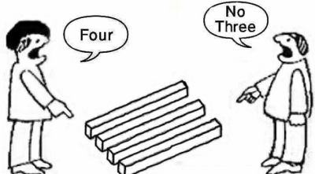
Test Driven > Test First
Notes:
I said earlier that tests are first class citizens, and that our production code is literally driven from the test.
Hopefully in the demo you saw this in action:
- I created a test to execute a non existent method, of a non existent class
I then used the tools available in the IDE to generate the production code according to the API created within that test
This obviously has the advantage of needing us to type less, so speeds the process up.
But the real value, for me, is that the process allows you to flip roles, from that of a developer or producer, to that of a user or consumer.
This gives you a different perspective, And in doing so, you naturally make the code easier to use…. which also makes it easier to test.

Slide 17

How?
Notes:
How does Test Driven Development make testing easier?
Well, because you are approaching design from the point of view of someone who is trying to test the software, you will deign software that is easy to test.
Rather than creating software solely to implement the requirements on a ticket, and then trying to test that implementation.
It’s all about dependencies…implicit dependencies vs explicit dependencies.
What do I mean by dependencies?
A dependency is anything your software needs in order to do its job.
This could be input arguments, as with the example we’ve just seen, or they could be something downstream such as a database or the file system, a remote web service, or something like the system clock.
How easy your software is to test basically comes down to how you manage those dependencies.
Let’s say for example that we want to build a class that calculates a persons age from their date of birth.
To do that, we are dependent on 2 things:
A date object representing a date of birth
And the current date
Now this isn’t a difficult calculation to work out – you’ve probably all already implemented it in your heads already

Slide 18
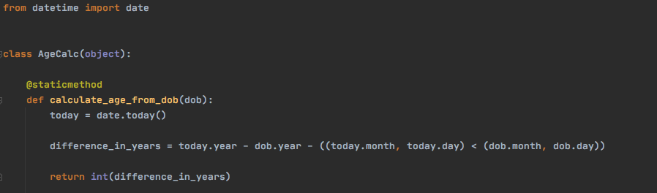
Hard to Test Code
Notes:
If you had something like this in mind, then I’m afraid you are going to have a hard time testing it.
Not because calling this code is hard, and not because getting the test to pass is hard, but because while your test may pass today, it’s not going to keep passing forever.
Eventually that system clock you’ve taken a dependency on is going to tick over to a new year and your tests are going to start failing.
Why?
Well there are 2 reasons:
Because your code has more than one responsibility…in that it needs to BOTH
determine the current date
AND use that date to calculate your age
You have no control over your dependencies – in this scenario, the system clock
Luckily we can fix these issues and make our code easier to test

Slide 19
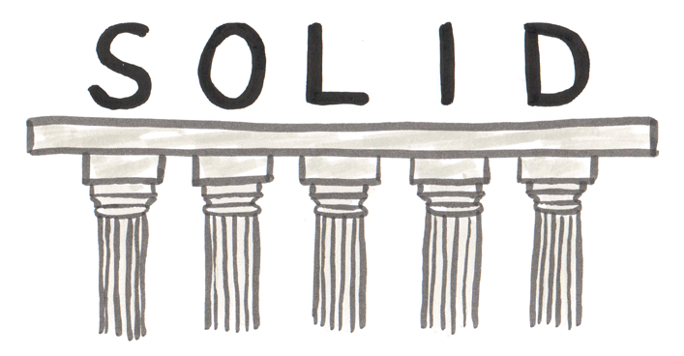
Introducing (maybe) S.O.L.I.D Principles
S – SINGLE RESPONSIBILITY
O – OPEN / CLOSED
L – LISKOV SUBSTITUTION
I – INTERFACE SEGREGATION
D – DEPENDENCY INVERSION
Notes:
Yep, sorry, potentially another new term here for some of you.
The SOLID Principles.
These are 5 design principles intended to make software more flexible and maintainable, but actually, they also make it much easier to test as well.
Now I’m not going to go into each one in fine detail – I do think they are important, so well worth reading up on these, But I really only wanted to highlight them to make you all aware of their existence.
These could easily form the basis of their own workshop.
The reason I mention them at all is because our current implementation of the age calculator breaks both the Single Responsibility and Dependency Inversion principles…so its these that we’ll discuss a little more.

Slide 20
Single Responsibility
“A class should have only one reason to change”
The Age calculator has 2 reasons to change
How we figure out the current date
How we calculate age
Notes:
So, the Single Responsibility principle states that a class or object should have only one responsibility, or one reason to change.
Now this doesn’t necessarily mean that our classes should all only ever have one method….
No, it simply means that the responsibilities of a given class or object should all be related.
So an object that is responsible for Body Mass Index related tasks, for example, should not also be responsible for Age Calculation – these are two different responsibilities.
And our current age calculator has 2 responsibilities.
Working out the current date is not it’s job, the age calculator has taken on the responsibility of someone else, and in doing so, made testing our calculator harder.
So we need to move that responsibility out of the calculator.
Now you may be thinking that we have already done this…the responsibility of working out the current date belongs to the datetime object.
And in a way you are correct.
But our Age calculator is still responsible for managing that dependency, and it’s this tight coupling that we need to break, as we’ll see shortly

Slide 21
Dependency Inversion
“1. High-level modules should not depend on low-level modules. Both should depend on abstractions.
2. Abstractions should not depend on details. Details should depend on abstractions.”
Basically, don’t depended on a specific implementation of something that has a responsibility, instead depend on a contract.
Notes:
Now the Dependency Inversion principle basically says that instead of relying on concreate implementations of particular behaviours, you should instead depend on an abstraction which provides the required behaviour, but can actually be fulfilled by one or many different implementations.
So to put this in more concrete terms….our age calculator currently breaks that principle because it takes a direct dependency on the datetime object to get the current date, rather than an abstraction…we can describe it as being tightly couple to the datetime object.
To fix it, we need our calculator to take a dependency on SOMETHING which promises to provide us with the current date, just like the datetime object, but isn’t necessarily the datetime object.
This is referred to as loose coupling….we prefer objects that are loosely coupled, rather than tightly coupled, as they are easier to test.
Lets have look at some code that hopefully clears this up.

Slide 22
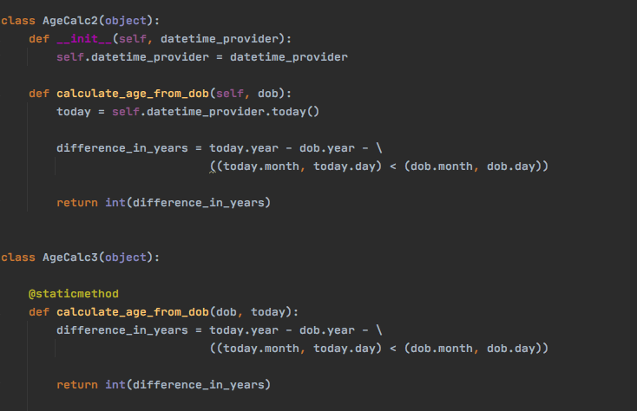
Dependency Inversion
Notes:
So here we have 2 ways to solve our current problem (which is that our calculator is difficult to test, not that we are breaking 2 solid principles!)
Remember, we are not trying to use SOLID Principles in and of themselves, they just help us identify the smells… we are trying to use them as tools in order to solve problems.
So our first refactored version of the age calculator (AgeCalc2) is now no longer a static method.
Now we need to create an instance of the the AgeCalc2 class.
And in order to create an instance of this class we need to provide it with an instance of a datetime_provider.
Then when we execute the calculate function, we call a method on that datetime_provider abstraction, which returns us the current date.
So we’ve moved the responsibility of working out the current date into a dependency, and crucially, we are moving the responsibility of creating and providing that dependency to somewhere else, to something higher up.
This code is now easy to test because we can instantiate our class using a instance of SOMETHING that implements our designed behaviour, while also being completely under our control….
We’ll see this in a test shortly.
Our second refactored calculator (AgeCalc3) takes a slightly different approach.
This time the method remains static, so we are not providing any dependencies via our object constructor.
Instead we simply provide the current date as an argument to the function.
Again, this moves the responsibility of working out the current date to somewhere else….The calculator doesn’t care where it comes from, only that it is available.
In both refactored versions of the calculator we have made our dependency on a datetime provider explicit, rather than implicit.
...
When the dependency was implicit, the consumer was not aware from the external API that a second date was required in order to calculate the age.
Neither our constructor nor the calculate method explicitly required the caller to provide these values. And this made it hard to test.
By making this dependency explicit, and having it passed in on either the constructor or the method, it makes testing easier because we are then able to control that dependency.
And if we can control our dependencies, we can predict the flow of logic through a function and therefore predict the output.
We also make the test deterministic….which is something we definitely want with test automation.
Random failures should be whittled out.
...
Ok, lets look at how we ended up testing each of these 2 implementations

Slide 23
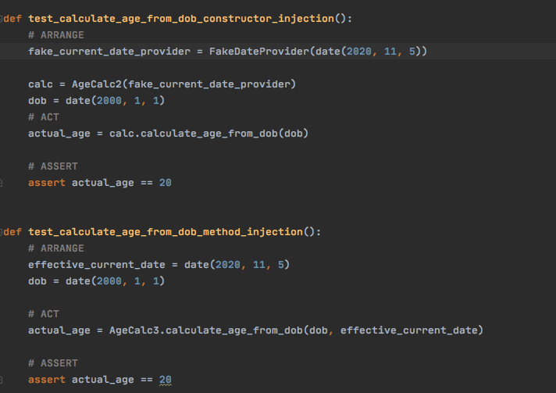
Dependency Inversion
Notes:
Here we have one test per implementation of our age calculators:
I first instantiates an instance of our age calculator, supplying an instance of a FakeDateProvider, which is simply a class that provides a parameterless function called Today, just like the real datetime date object.
Only unlike datetime’s date object, we are in complete control of what date gets returned when our age calculator executes the Today() method.
Our second test simply calls the Calculate method supplying 2 date arguments; the first is the date of birth, and the second is the current date, or at least the current date in terms of the test scope.
Both of these tests are:
Deterministic
Repeatable
Reliable
And completely under our control
Because our Api was designed with testing in mind.
This is why Test Driven is better than test first, because the test driven approach forces you to think this way from the offset.
Therefore you don’t implemented code that is hard to test.
Therefore testing is easier.

Slide 24
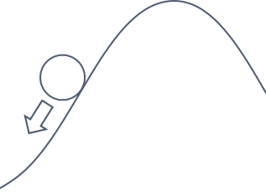

Test First Vs Test Driven
Uphill Struggle
Pitt of Success
Notes:
Now, you may be thinking that you could have created code that is open for testing without Test Driven Development
And you are correct, you can: and a lot of experienced devs can, and do, do this.
But that is because they know how to make software that is easily testable, because they have been through this process, gone through this learning curve.
TDD provides you with a process that naturally leads you down this path, which is great for those new to coding, and those new to automated testing.
It leads you into the pit of success

Slide 25

Demo Review: Potentially new concepts
Test Driven is Different to Test First
Arrange / Act / Assert
Red, Green, Refactor
Developer Productivity Tools
Feedback Loop(s)
Notes:
So skipping back to the review of our demo.
We’ve covered TDD vs Test first, and Arrange Act Assert.
Now let’s talk about Red, Green, Refactor….what’s that all about?

Slide 26
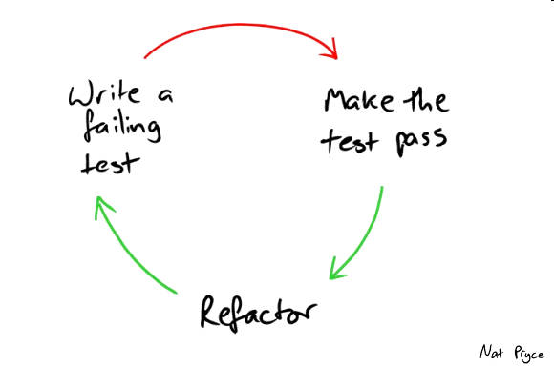
Red, Green, Refactor
Notes:
This is basically another process within the TDD process, that helps you keep focused on one thing at a time, limit the scope of change, and ensure that our code works while eliminating false positives.
I goes like this, and hopefully you can reflect back on the demo as we walk though it:
In the Red Stage we are focused on creating the test, and getting that test to execute correctly:
First we write a test that asserts what it is we are trying to achieve. This also drives our implementation of the production code….and we create just enough of the production code so that the test will run. Not that I said run, not pass!
We then run the test and see our test fail – it can’t possibly pass at this stage, we haven't actually written the implementation to make it pass yet
In the Green Phase our focus changes to making the Test pass.
We write just enough code in our production implementation to make the test pass: and this code can be ugly as hell and grossly inefficient at this stage….we are focused only on making it work
We don’t change the test at all – that remains a constant
We run the test and see it pass
Finally, in the refactor Phase, our focus shifts again, this time to matters of elegancy, readability and performance
We make tiny, incremental changes to either our production implementation, or the test, never both, improving the code in whatever way you feel necessary
We re-run the test to ensure that it’s still green
And you repeat that process until you are finished.
None of the steps should be skipped, as they are all important

Slide 27
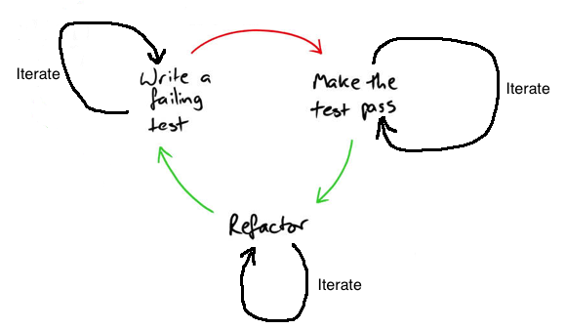
Red, Green, Refactor
Notes:
In reality, the diagram looks more like this; as we iterate through each of the phases numerous times before deciding to progress to the next phase.
In the Red phase, particularly in a dynamically typed language where there isn’t a compiler preventing you from running a test it knows can’t run, we may take several attempts to write both the test, and just enough production code for the test to execute and fail only because the implementation has not yet been written.
For example, you may forget to create the subject under test, and the test will fail to run.
This is not the same as failing because the assertions didn’t match the expectations.
In the Green phase, you may write code that you think will make the test go green, but in fact contains bugs.
So you may go through several iterations of changing the code and running the tests before they pass.
In the Refactoring stage there may be lots of things you want to do to improve the code:
Increase performance, reduce duplication, more clearly express intent, or improve readability
With each incremental change, we re-run the tests and receive feedback on how we did – pass or fail

Slide 28
Red, Green, Commit, Refactor, Commit
Notes:
Actually, we can extend this process further to include source control too.
If we create local commits to our repository once we have our test passing, and after each successful refactoring, then we create safe restore points to roll back to if and when we decide to bail on our current refactoring: either because we decide it’s not worth the effort, or you prefer it better the way it was, or whatever reason.
It means you can quickly get back to a good state where the tests are all green, without wasting any time or effort cherry picking the things you want from the things you don’t.
Red Green Refactor is all about good behaviours during development,
And should be your new mantra

Slide 29
Demo Review: Potentially new concepts
Test Driven is Different to Test First
Arrange / Act / Assert
Red, Green, Refactor
Developer Productivity Tools
Feedback Loop(s)
Notes:
Right – lets talk quickly about Productivity tools

Slide 30

Productivity Tools
Learn shortcuts and hot keys
Practice without the mouse
Let the IDE to the heavy lifting
Sync shortcuts across the team if pairing
Notes:
In the demo you saw me use shortcuts and tools built into the IDE in order to speed up the process, creating code for me, simplifying refactoring, and reducing my work load.
I recommend that you take the time to learn about the productivity tools built into your IDE, learn the shortcuts available, get to know your way around.
Yes, this will take a bit of time to learn, but once the muscle memory kicks in it becomes second nature, and you will definitely go faster.
If you are not using an IDE that gives you the sort of experience you saw in the demo, where you can create large chunks of code automatically, or refactor efficiently, or re-run the test with a quick hot key combo, then I seriously advise you change your IDE.
It will not only make you more productive, but it makes you a happier Developer…
Seriously, I think this is one of the MOST underrated, least discussed topics in software development…
If the reason you are using an IDE that does not provide you with this experience is because of licencing costs then get your DM to resolve that immediately.
I licence is sub £200 quid a year, and you will easily make back up in productivity boosts over the course of a year.
Lastly:
If you are a team that pairs a lot, then I recommend the whole team uses the same shortcuts and hot keys – just for a consistent experience across machines (you know, for when sharing keyboards is a thing again!)
In the past I have worked in a team who did regular code katas and coding exercises for us all to improve. One of those exercises, which we did a few times, was to see if we could go the whole day without using the mouse once – I highly recommend it

Slide 31
Demo Review: Potentially new concepts
Test Driven is Different to Test First
Arrange / Act / Assert
Red, Green, Refactor
Developer Productivity Tools
Feedback Loop(s)
Notes:
Lastly – feedback loops

Slide 32
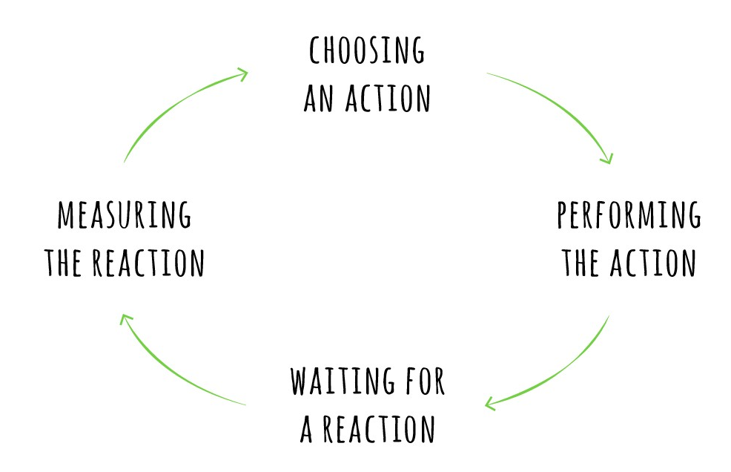
Feedback Loops
Notes:
What am I talking about when I talk about feedback loops?
Regular execution of our test suit is a feedback loop that lets us know if we have broken anything while making changes.
It’s a great mechanism – it’s got your back!!
But its only great if you look after it.
Keep feedback loops short/fasts/reliable/repeatable
Slow feedback loops will be run less often
Unreliable or flakey feedback looks will become a source of irritation, and it left unchecked downright annoying
Once this happens, people stop running them locally, and tests only run on the CI server….this makes feedback loops even bigger, and slower, and problems get worse.
You need look after your test suites and ensure they are always fast and reliable, so that everyone runs them frequently, and you get fast feedback on your progress.
Your tests are you friends.
Your tests are first class citizens.
Your tests deserve the same level of investment as your production code.
Look. After. Them. Please!

Slide 33

Things to remember
Don’t add production code without a failing test
Don’t test private methods
Don’t test the Language/Framework/Library
Notes:
Right, it’s nearly time for an exercise, but first, some quick rules
First:
Never write any production code unless it makes a failing test go green.
If you want to add new code, first add a failing test or test case.
This way, you know that all our code is covered by at least one test….because you wrote the test first
Second:
Don’t test private methods explicitly.
Private methods should only ever have been created during the refactor phase of Red Green Refactor. They will therefore be called by at least one public method….and as all our public methods are created from tests, it means that our private methods are covered.
Third:
Don’t explicitly write tests to check that the Language, or a Framework or a library you are using is working correctly.
Partly because that’s the job for the people to built it, not you, and partly because it’s going to be covered implicitly anyway.

Slide 34
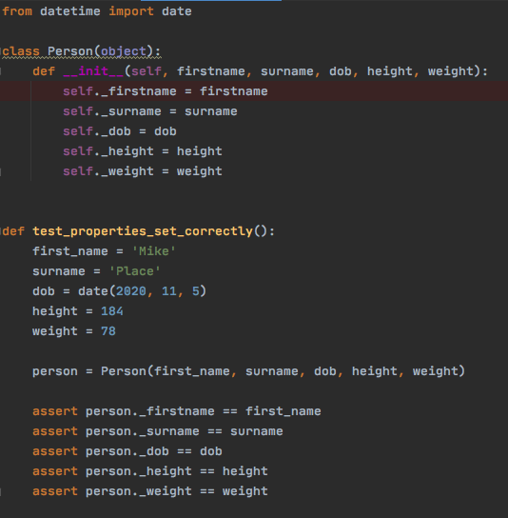
Notes:
Consider this code as an example:
This test is pointless because it only really tells you that there isn’t a bug in Python.
Now, you may argue that there could be a typo, or I made a copy and past error and assigned first name to the surname property.
Ok….but if we are following TDD so we only created the Person Object and these properties in order to make a failing test go green….
So our constructor logic is covered implicitly… and the only thing this explicit test is doing is adding more code for us to maintain going forward.

Slide 35

Notes:
Right.
Time for you lot to give it a go and put all this into practice.
...
I’m going to be the product owner and you guys are going to build me a report generator. So I won’t be doing any coding, although I will be flipping roles between product owner and mentor to give you some direction if needed.
Context:
I’m looking to launch a new marketing campaign to push a new home insurance add-on product to existing home insurance customers.
However, it’s a pretty niche product, so we will only be targeting male homeowners within a certain age bracket.
There are 2 report formats required. Which format the results are displayed in is dependent on the result of call to the MVT web service – we are basically A/B testing to see which format is the most successful.

Slide 36
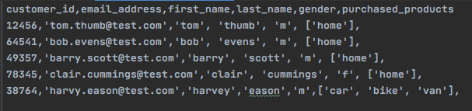
Customer Data Schema
Notes:
Here is the database schema for our customer data, with a few samples so you can see what we are dealing with.
I’ve already created a git repo with some things in to kick us off…This schema is in there, so you don’t need to consume of that just now.
This is also available in JSON if that is more useful to you.
We are gong to assume that this is a mongo database we are connecting to…since that is relevant to your current project (so a little bird tells me)

Slide 37
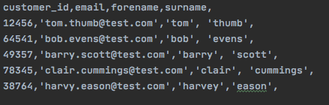
Output: 2 Report Formats
Notes:
Now the 2 different report formats are
The complete customer dataset that we’ve just seen, and
What we call a TargetedCustomer, which looks like this:
Again, this is in the repo and is available in JSON format too.
So basically, for one report you’ll need to map raw customer data into this format here, and for the other, you can just output the raw customer data without mapping to a new format at all.

Slide 38
Git Repo
https://github.com/dcook-net/tdd_workshop
Notes:
Here is the Git repo url, which through the magic of Teams you may just be able to click to open
So what we need now is for someone to volunteer to be our pilot: share their screen and do some typing while the rest of you drive.
Any takers?

Slide 39

grandprix lights
Notes:
Lets GO!

Slide 40

Notes:
Any Questions ?

Slide 41

Test Double by Martin Fowler – details the difference between different test doubles
Test && commit || revert by Kent Beck – Interesting post about a variation on Red, Green, Refactor
Test-Driven Development by Example by Kent Beck
RGRC by Steve Smith – Post on Red, Green, Refactor: Commit often
Resources

Slide 42
Test-Driven Development with Python by Harry Percival (Available to read online for Free)
Prefer Fakes over Mocks by Alexey Golub
Resources

